Slide 1
Creating an Ethical Work Environment
Julie O’Sullivan-Maillet, PhD, RDN
May 13th, 2016
Association for Healthcare Foodservice of New York

Slide 2
Today’s aim
Provide you references that may be valuable to you
Help you think broadly about ethics in the workplace
Reminder you that many eyes are on you
Encourage you that quality always includes ethics and can improve the workplace environment

Slide 3
Suggested References
American Dietetic Association/Commission on Dietetic Registration. Code of Ethics for the Profession of Dietetics and Process for Consideration of Ethical Issues. Journal of the American Dietetic Association. 2009: 109 (8): 1461-1467.
Academy of Nutrition and Dietetics, Quality Management Committee and Scope of Practice Subcommittee. Scope of Practice in Nutrition and Dietetics. Journal of the Academy of Nutrition and Dietetics. 2013: Suppl 2, 113(6): S11-S16.
Position of the Academy of Nutrition and Dietetics. Ethical and Legal Issues in Feeding and Hydration. Journal of the Academy of Nutrition and Dietetics. 2013: 113 (6): 828-833.

Slide 4
References continued:
Academy of Nutrition and Dietetics, Quality Management Committee and Executive Committee of the Management of Food and Nutrition Services DPG. Revised Standards of Professional Performance for Registered Dietitian Nutritionist in Management of Food and Nutrition Systems. Journal of the Academy of Nutrition and Dietetics. 2014: 114(7): 1104-1112. Details electronically same volume 112.e1-e21.

Slide 5
References continued:
Sauer K. Ethics in Action: Ethical Considerations in Management Practice. Journal of the Academy of Nutrition and Dietetics. 2016: 116 (1):148-149.
Barkley WC. Ethical Practice in Foodservice Management. Journal of the Academy of Nutrition and Dietetics. 2012:suppl 2, 112 (5):S41-S42.
Zeitler NW, Luisi L. Ethics in Action: Criminal Background Checks for Employment. Journal of the Academy of Nutrition and Dietetics. 2016: 116 (4): 692-694.

Slide 6
Broader References:
New York Recording Law. Digital Media Law Project. Accessed 3/14/16 at http://www.dmlp.org/legalguide.
Tucker ME. New Guidance on Diabetes Care in Elderly Residential Facilities. Feb 2, 2016. Accessed at http://www.medscape.com/viewarticle/858152_print.
Haggin P. As Wearables in Workplace, Spread, So Do Legal Concerns. Wall St Journal. March 13, 2016
Phillipss JP. Workplace Violence against Health Care Workers in the United States. N Engl J Med. 2016; 374: 1661-1669.
Gandhi TK, Berwick DM, Shojania, KG. Patient Safety at the Crossroads. JAMA. 2016; 315 (17): 1829-1830.

Slide 7
“Quality means doing it right when no one is looking.” Henry Ford.
“Ethics is essential to quality.” me.

Slide 8
Key Professional Documents
AND/CDR Code of Ethics
Scope of Practice
Standards of Professional Performance in Management of Food and Nutrition Systems

Slide 9
Ethical Breaches

Slide 10
Ethical Breaches
All eyes on you even for small items
Cutting corners
Fudging dates or temperatures or what ever
Improper exchanges
Non secure information, data breaches
Not shredding confidential information
Accessing records, inappropriately
Sharing confidential information
Retaliation

Slide 11
Criminal background checks
When?
Why?
Does it discriminate?

Slide 12
Competency assessment of all
Your obligation to safety
Your obligation for sufficient training
Your obligation if you think a disability

Slide 13
Reducing bias in decision making
Time sensitive
Visual bias
Relationship bias

Slide 14
Environment Ethics
Sustainability
Waste management
Conservation

Slide 15
Currency
individual rights
institutional obligations
best practices
teamwork

Slide 16
Appropriate Use of Technology
Tracking whereabouts
Productivity
Taping, ethical vs legal considerations
Tracking health and fitness
Freedom (?) of speak

Slide 17
Ethical Work Environment

Slide 18
Ethical Work Environment
Valued
Trust
Open conversations
Autonomy and accountability
Diversity in multiple ways
Honest
Progressive
Learning and innovative values

Slide 19
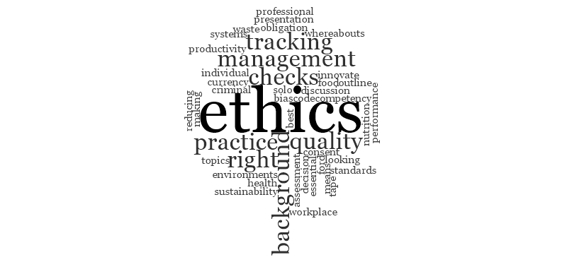
Ethics Wordmap

Slide 20
Moral obligation to innovate
Change is hard
Does not equal improvement, but
All improvement requires change
Experimenting is crucial to creativity breakthroughs
Experiment to test assumption
Failed experiments is still learning
Small steps, quickly measured stimulate change
Better you shape the change than it change you
Needs to be realistic in action and defined in realistic timeframe

